Slide 1
Data 621 Final Project
Wine Quality
Group 1
Slides organized by Jun Pan

Slide 2
DATA Source
Got from UCI machine learning repository

Slide 3
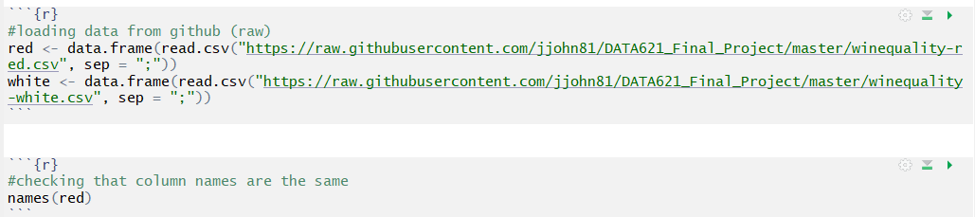
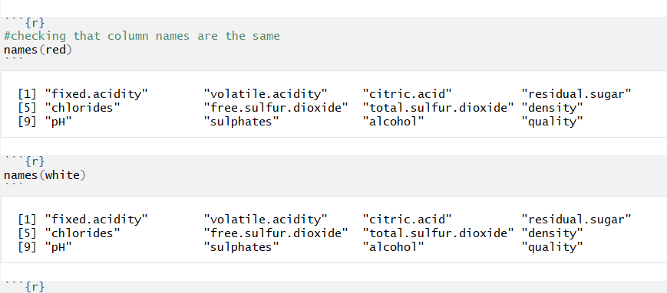
Load red wine and white wine data Check variable names

Slide 4
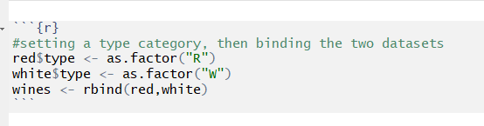
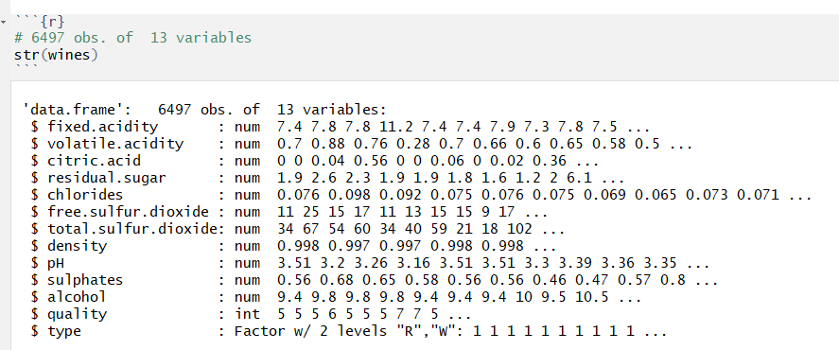
Merge the red win and white wine database Show structure of database

Slide 5
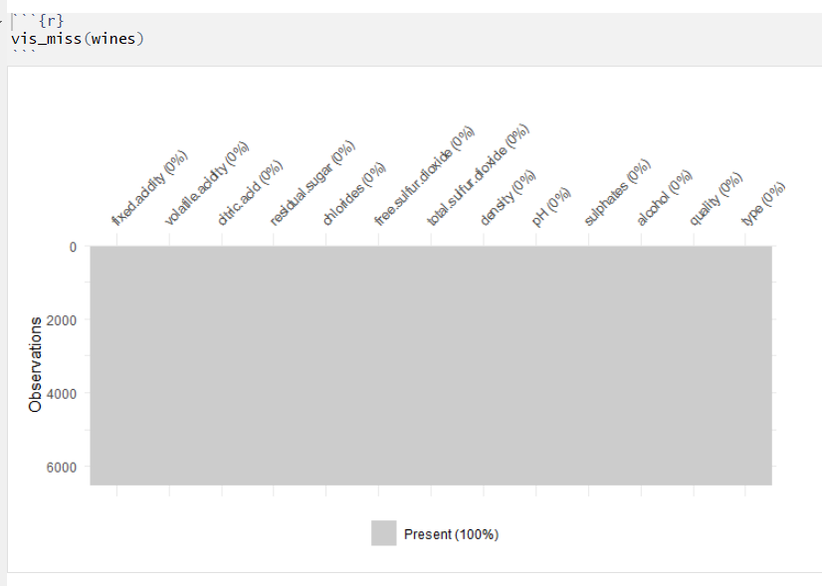

Slide 6
So far, we do not have missing data. We finished data exploration.
Then, we merge the two wine data base together and created a new column type. So we finish the data transformation.
According to our regular assignment. The first two parts have been finished.
Then, we need to create at least three prediction models.
The last we, we have to compare the different prediction models.

Slide 7
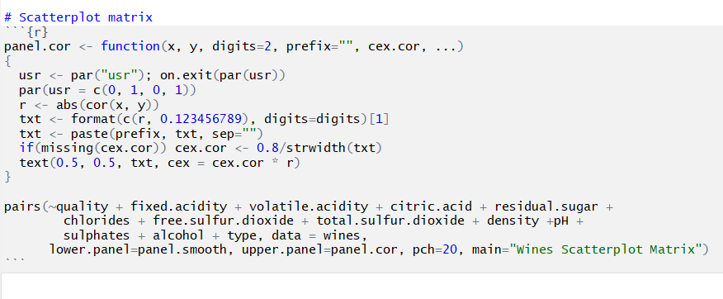
Correlation Matrix

Slide 8
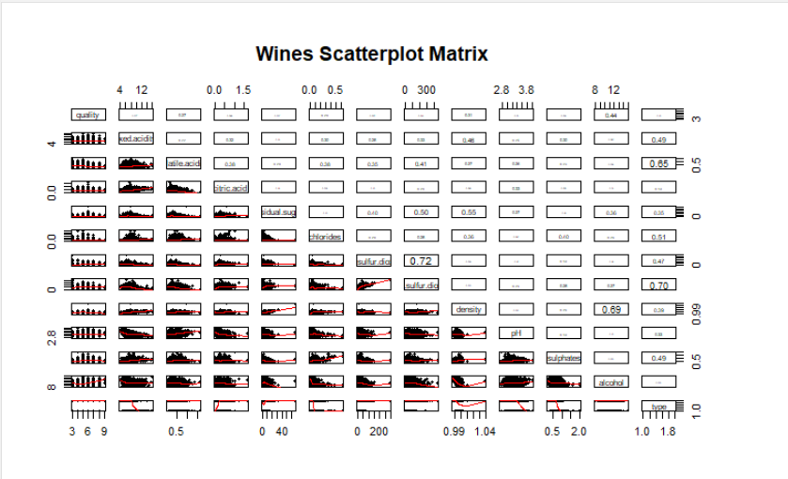

Slide 9
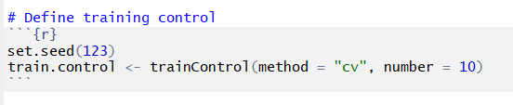
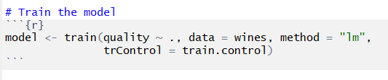
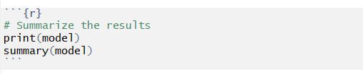
Linear Regression with Repeated 10-fold cross validation
Reference: http://www.sthda.com/english/articles/38-regression-model-validation/157-cross-validation-essentials-in-r/

Slide 10
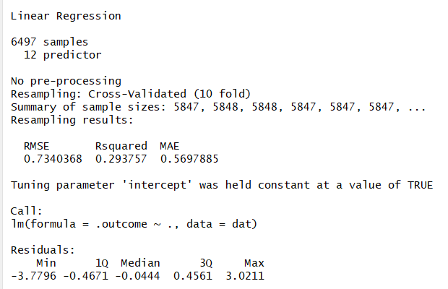

Slide 11
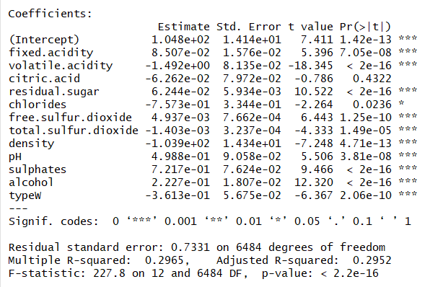

Slide 12
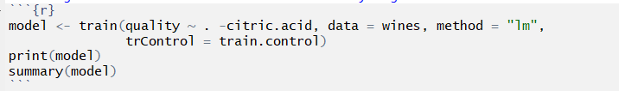
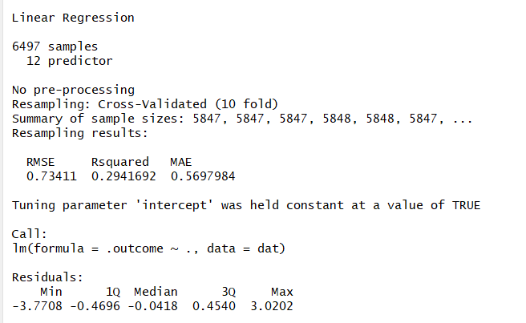
Because there is no effect on citric acid concentration in previous model, we removed this attributes in the new model

Slide 13
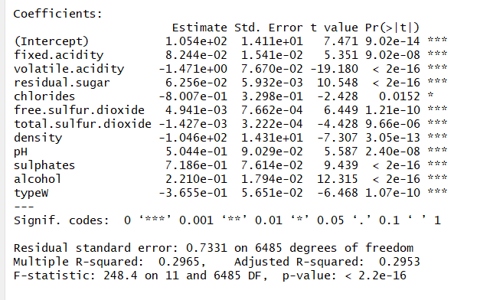

Slide 14
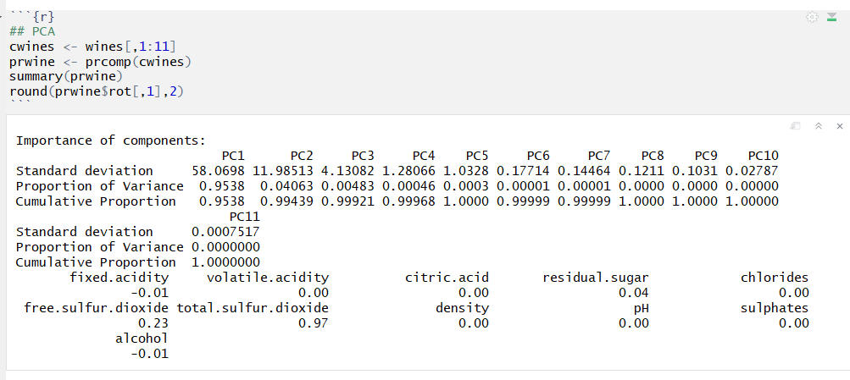
Further prove that citric acid does not contribute to wine quality

Slide 15
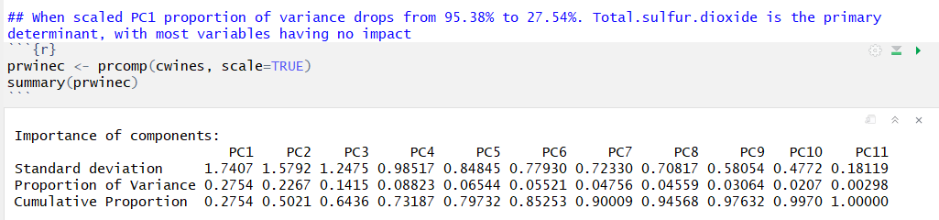
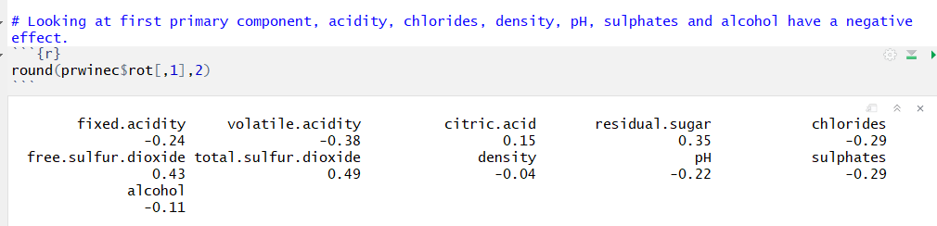

Slide 16
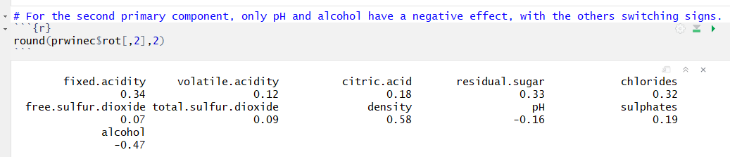
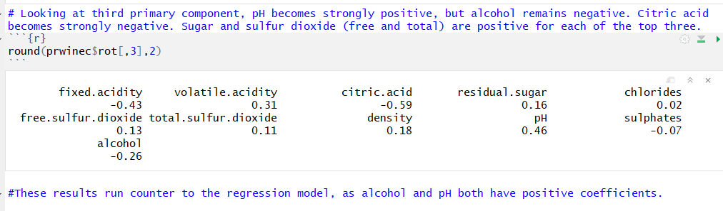

Slide 17
